Slide 1
Predict THE RIGHT BUSINESS

Slide 2
WHICH IS THE BEST BUSINESS ??
Restaurant
Shopping Mall
Resort with outdoor activities

Slide 3
Problem statement
KMAX a leading business company requires help to set up a new business in a good location in Mysuru, Karnataka, India.
Suggestion is required on which of the below three business would prove to be more profitable
Restaurant
Shopping Mall
Resort with outdoor activities

Slide 4
Location for business
They have selected the location to set up the business as Ring road which is near the industrial area and has major IT companies near by and the huge population stays in this area
Location for analysis
We have selected the latitude and longitude of Infosys, Mysuru which is very near to Ring Road to explore the near by top 100 venues with in 10KM radius

Slide 5
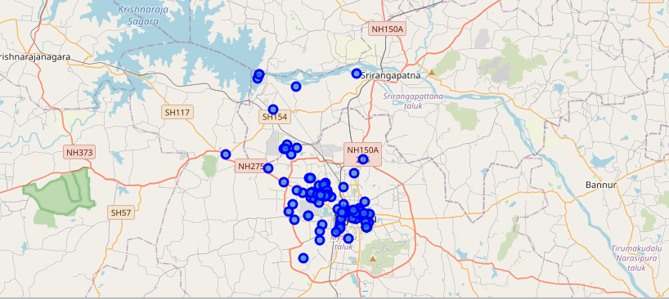
Data For the problem
The Map shows the list of top 100
venues present near to the selected location

Slide 6
METHODOLGY USED
Fetch the latitude and longitude of the given location
Define the foursquare credentials and version
Construct the URL to fetch the near by venues
Send the URL request and fetch the json values
Clean the Json and store it in data frame
Group the venues based on the category and display them in the descending order
Identify the business that are already present
Analyze the report and provide suggestion

Slide 7
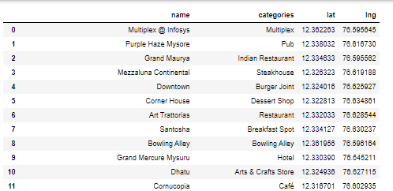
DATAFRAME
The retrieved information of the venues are converted to a data frame as shown. You can view the complete list here

Slide 8
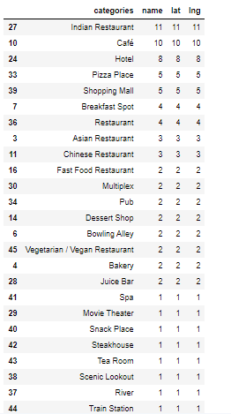
SAMPLE OF THE RESULT
The table shows the result of the data grouped based on categories. It is very clear that the restaurants tops the list You can view the complete list here

Slide 9
Comparison OF THE RESULT
Indian Restaurants tops the list and shopping mall is the fifth in the list

Slide 10
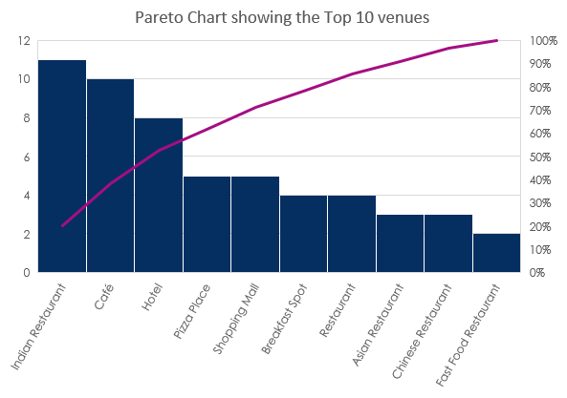
TOP 10 VENUES BASED ON CATEGORY
An analysis done on the top 10 venues shows that
9 out of the 10 places are related to places that
serve food and beverages. So it might not prove
to be more profitable to open a restaurant in the
same location

Slide 11
Restaurant Vs Shopping MALL
You can also see that shopping mall is 5th in the list and there are already 5 shopping malls
Mysuru is a tier 2 city with less population
unlike Bangalore or Mumbai
Since there are already 5 shopping malls, it does not look to be a good suggestion

Slide 12
RESORT WITH OUTDOOR ACTIVITY
As the location chosen is near to major IT companies, it looks to be a good suggestion
to open a resort with outdoor activity
Based on the analysis done, there is only one resort present in the locality
So KMax can look at opening a resort with outdoor activity which may prove to be more profitable compared to restaurants and shopping malls

Slide 13
Conclusion
Resort with outdoor activities looks to be a better suggestion compared to restaurants and shopping malls

